Slide 1
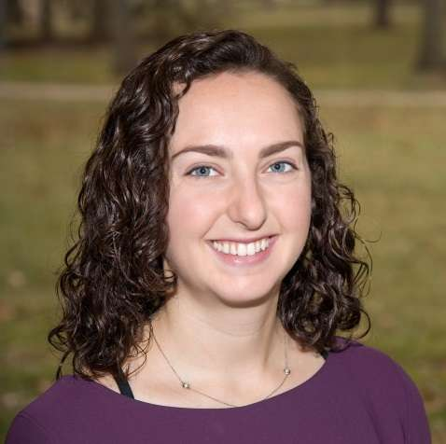
The MassTrac Legislative Tracking Service
(An InstaTrac Inc. Company)
January 8th Webinar
Presented by Company Founder Michael Segal
Thanks for joining us! A few instructions before we begin:
You may join the audio by selecting the radio button for either “Telephone” or “Mic & Speakers.” If you are using telephone, please dial in with the conference line and audio pin provided.
If you are having any technical issues, please let us know in the chat box.
We will have time for Q&A. Please enter your questions in the chat box at any time.
This webinar is being recorded, and we will distribute the recording after the webinar.
Madeleine Morgan
Programs and Services Manager
www.massnonprofitnet.org

Slide 2
Public Policy / Advocacy
Danielle Fleury
Director of Government Affairs
dfleury@massnonprofitnet.org
MNN’s policy work
Advocacy in your organization
Overview of resources

Slide 3
MNN’s Policy Work
Direct advocacy
Cross-sector policies impacting the sector
*MNN public policy agenda attached*
Advocacy capacity building
Policymaker roundtables
Webinars, in-person trainings
Office hours
Raising awareness
Commonwealth Insights
MemberNews, SectorNews

Slide 4
The Importance of Nonprofit Advocacy
Informing the public policymaking process with subject matter/technical expertise
Connecting elected officials to their communities
Representing constituents in need & giving them a voice
Avoiding the cost of not engaging
Leveraging a strong collective voice:
551,117 nonprofit jobs in Massachusetts
Almost 18% of the MA workforce dedicated to serving the public good

Slide 5
Advocacy Resources
MNN’s website
http://massnonprofitnet.org/advocacy/
Individual policy/advocacy meetings: MNN office hours
http://massnonprofitnet.org/new-member-benefit-office-hours/
Bolder Advocacy
https://bolderadvocacy.org/resource-library/

