Slide 1

Protecting Your Nonprofit’s IT Security
Why should you care about safe computing?

Slide 2

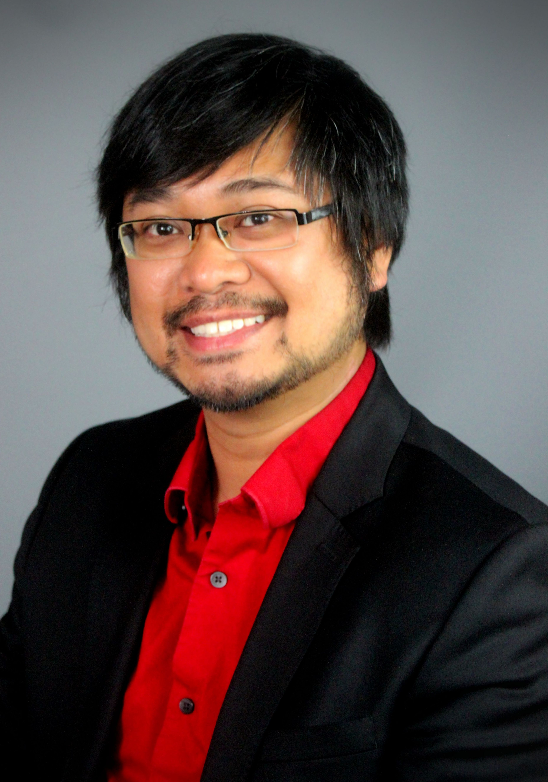
Presenters
Ken Boyle
Director of Sales and Marketing
Tech Networks of Boston
Tuan Pham
Chief Executive Officer
Tech Networks of Boston

Slide 3
Agenda
A broad overview of cybersecurity in today’s news
Case Study example of a common IT security breach
Best practices and tips you can bring back to your staff
Questions and Answers

Slide 4
Today’s Goals
You’ll understand the dangers of cyber crime.
You’ll understand the various ways that criminals are targeting your nonprofit
You’ll be able to bring back some actionable items to your team
You’ll have further questions about security in general

Slide 5
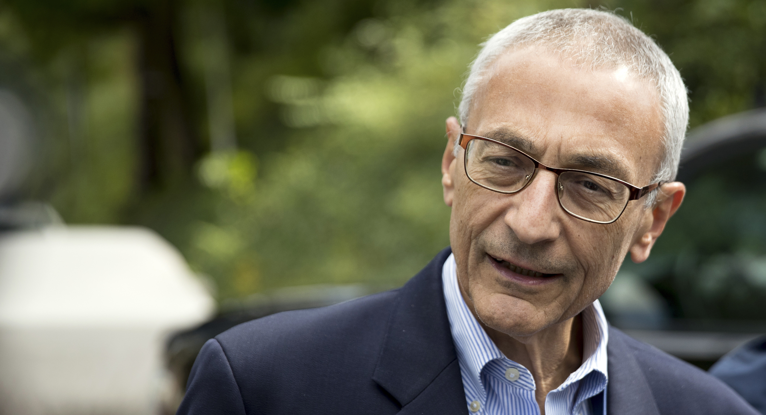
Do you know who this is?
Notes:
Poll question and MNN tells us the answers.

Slide 6
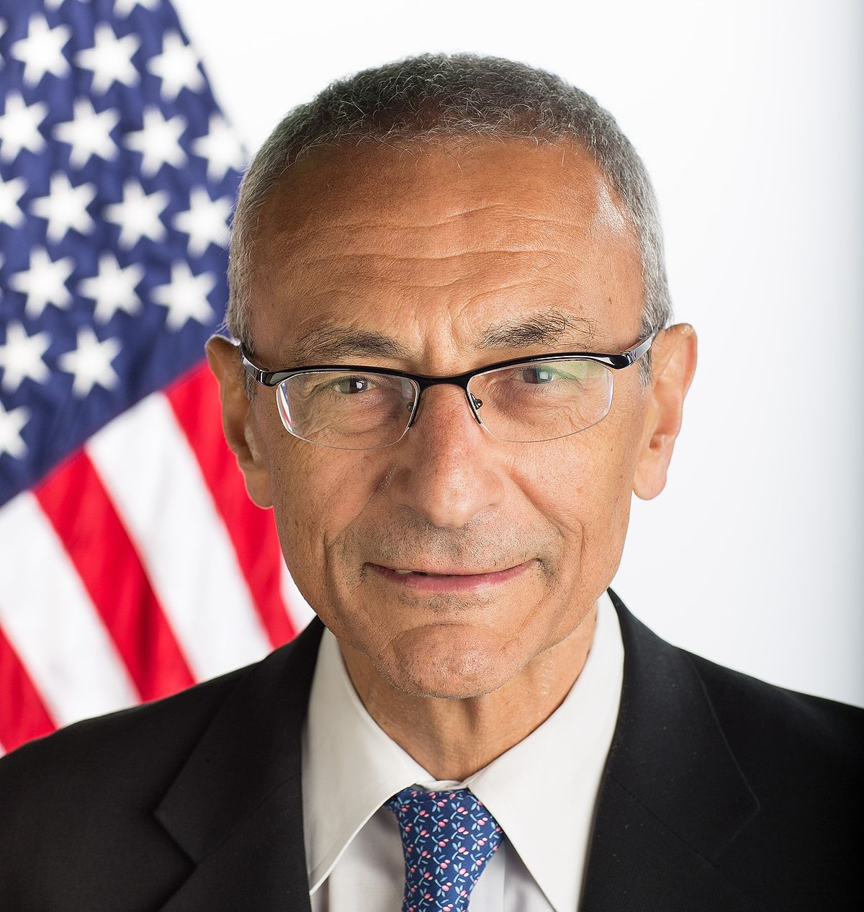
Cyber Security in the News
John Podesta was the former chairman of the 2016 Hillary Clinton Campaign.
In October 7, 2016, thousands of his personal emails were published on the Internet, exposing Clinton’s positions and campaign strategy.
Podesta fell for a basic phishing attack where someone stole his Gmail password.

Slide 7
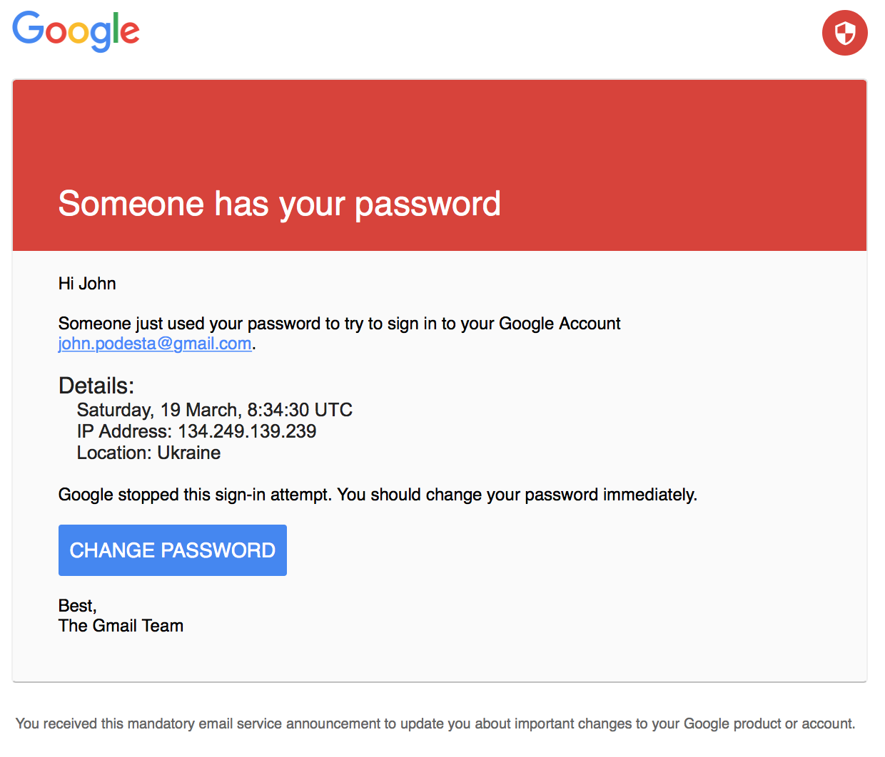

Slide 8
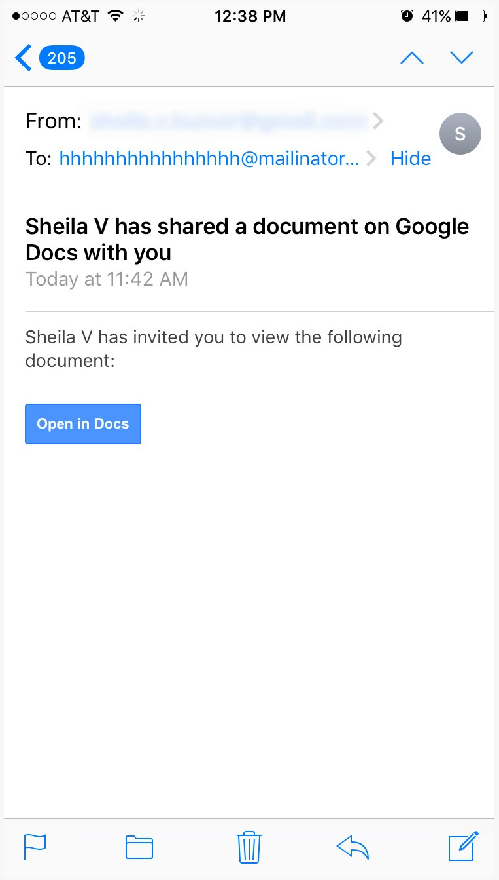
And, it’s just not people in power…
Earlier this year, a cyber criminal sent out a fake Google Docs link.
When clicking the link and logging in, users gave away their address books, email passwords and email history to an unknown source.
Phishing scheme lasted for roughly six hours, but affected more than a million Google Apps users.

Slide 9
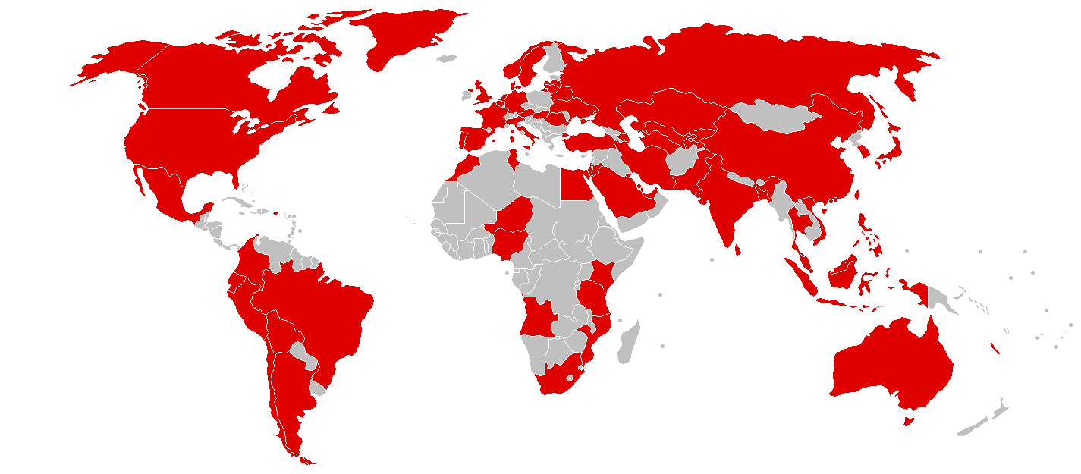
What is this a map of?

Slide 10
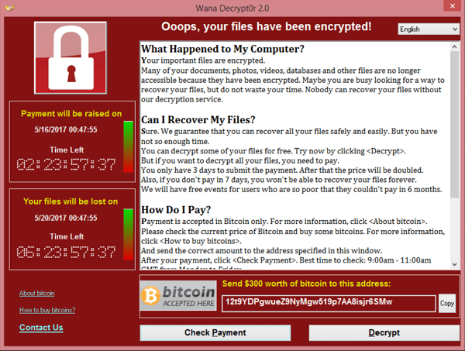
WannaCry made many IT pros cry.
WannaCry hit 230,000 computers in 150 countries in less than four days
The software completely encrypted the computer and any other workstation or server connected to it.
It cost $300 USD to get your computer unlocked if you didn’t have a good backup.

Slide 11

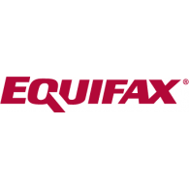
Cyber Security in the News
Yahoo
  News just came out that during their 2013 cyber attack, All three billion accounts were affected.
Equifax
  The credit reporting agency said that the confidential information of more than 145 million Americans has potentially been compromised.

Slide 12
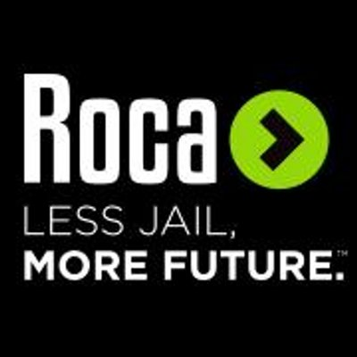
Nonprofit Case Study
Our client Roca, Inc. fell victim to an attack earlier this year.
Notes:
Roca's Mission is to Disrupt the Cycle of Incarceration and Poverty by Helping Young People Transform Their Lives. We have been their IT service provider for some time now.
For the past two years, Roca Inc. has been working with Tech Networks to review and consistently improve Roca’s security as part of an overall infrastructure upgrade. These preventative efforts ended up paying dividends when Roca was hit with a ransomware attack on Easter Sunday 2017. This attack made company files inaccessible, leaving most of their employees unable to work for several hours.

Slide 13
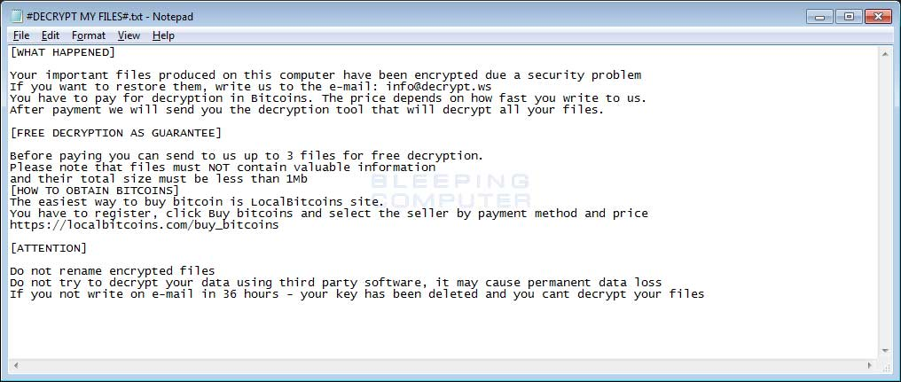
Nonprofit Case Study
  Hacker used a password generator to infiltrate an employee account
  Their files were encrypted and ransom notes were left in each folder demanding $
Notes:
The ransomware appears to have been introduced onto Roca’s network by a hacker using a password generator to infiltrate a staff account. One of Roca’s employees then noticed the files on their network drive looked different and could not be opened.
Upon further investigation, our engineer confirmed that the files were encrypted and ransom notes had been posted in all file folders. The Business Continuity Plan developed jointly by Roca and Eric Harris, Tech Networks’ IT Director assigned to Roca, had anticipated the risk of such an event, and established a recovery procedure for Roca’s data in the event that the worst should happen.

Slide 14
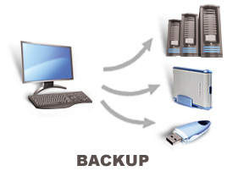
Nonprofit Case Study
  Having proper backups saved the day
Notes:
The recovery procedure incorporated the following preventative measures:
The file server had been configured to retain previous versions (shadow copies) of files with as much historical retention as possible.
Local backups were maintained.
The Endpoint Security solution was kept up to date on client workstations and the File Server.
A robust password policy was implemented via group policy on the Domain.
File access Auditing was enabled on the File Server.
Even with these measures in place, the ransomware was sophisticated enough to infect the server.

Slide 15
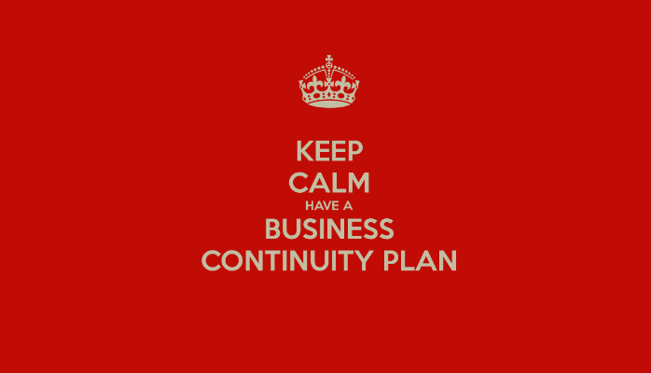
Nonprofit Case Study
Business continuity plan was executed
Notes:
Once the attack was recognized, Tech Networks staff immediately started working to isolate the affected machines to prevent further spread, and recover the infected files in order to get Roca back up and running. The first step was to find the user account that had been used to encrypt the files. Tech Networks then had all employees at Roca shutdown and unplug their workstations to remove them from the network. The most recent backup files were then restored, and checks made to ensure that there were no further signs of encrypted files or ransom notes. The user who had their account compromised had their computer wiped and then restored. With proper backups in place, the recovery process took only a few hours and the organization was back up and running, with no payment to the cybercriminals!
The ultimate key in beating ransomware is to prevent, not react.

Slide 16

There’s always a risk for an attack…
Anytime you open an email
Anytime you open search for something in Google
Anytime you open an unknown file
Anytime you open a USB drive attached to your computer
Anytime you open a link in Facebook
Anytime you connect to a public WiFi spot
And on and on and on….

Slide 17
Your staff is the easiest target…
A threat can be launched…
  Anytime you open an email
  Anytime you open search for something in Google
  Anytime you open an unknown file
  Anytime you open a USB drive attached to your computer
  Anytime you open a link in Facebook
  Anytime you connect to a public WiFi spot
  And on and on and on….

Slide 18
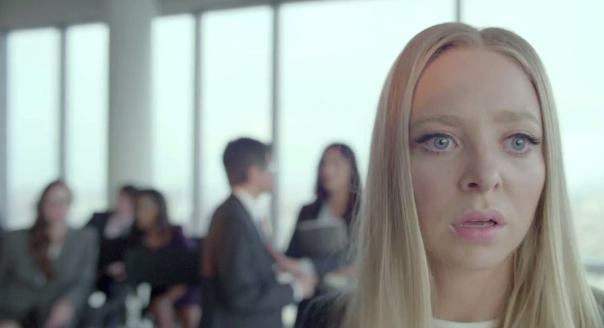
Some basic techniques
When you leave your computer, lock it. Press Control-L
Have a PIN or a password on your phone
Only download software from trusted sources
Be very wary of unknown removable media, like USB keys or CD/DVDs

Slide 19
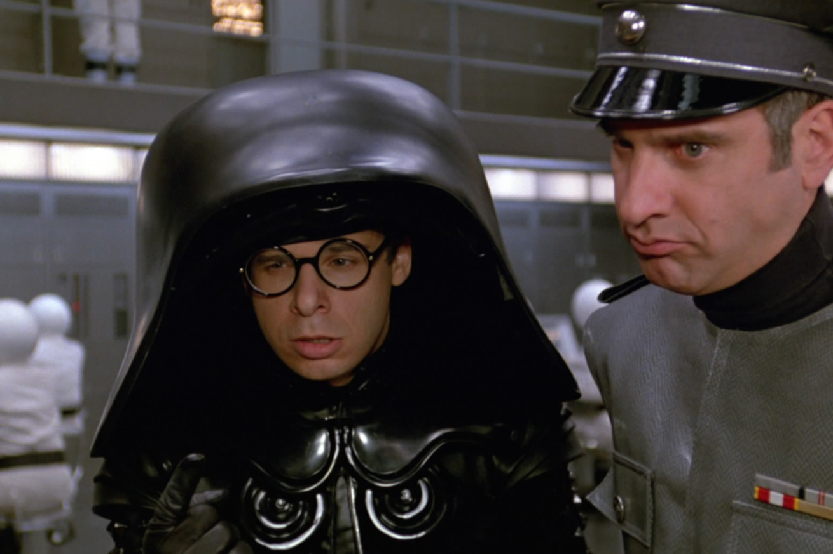
What is the most common password?
Notes:
Use strong passwords

Slide 20
The Most Common Passwords of 2016
123456
123456789
qwerty
12345678
111111
1234567890
1234567
password
123123
987654321

Slide 21
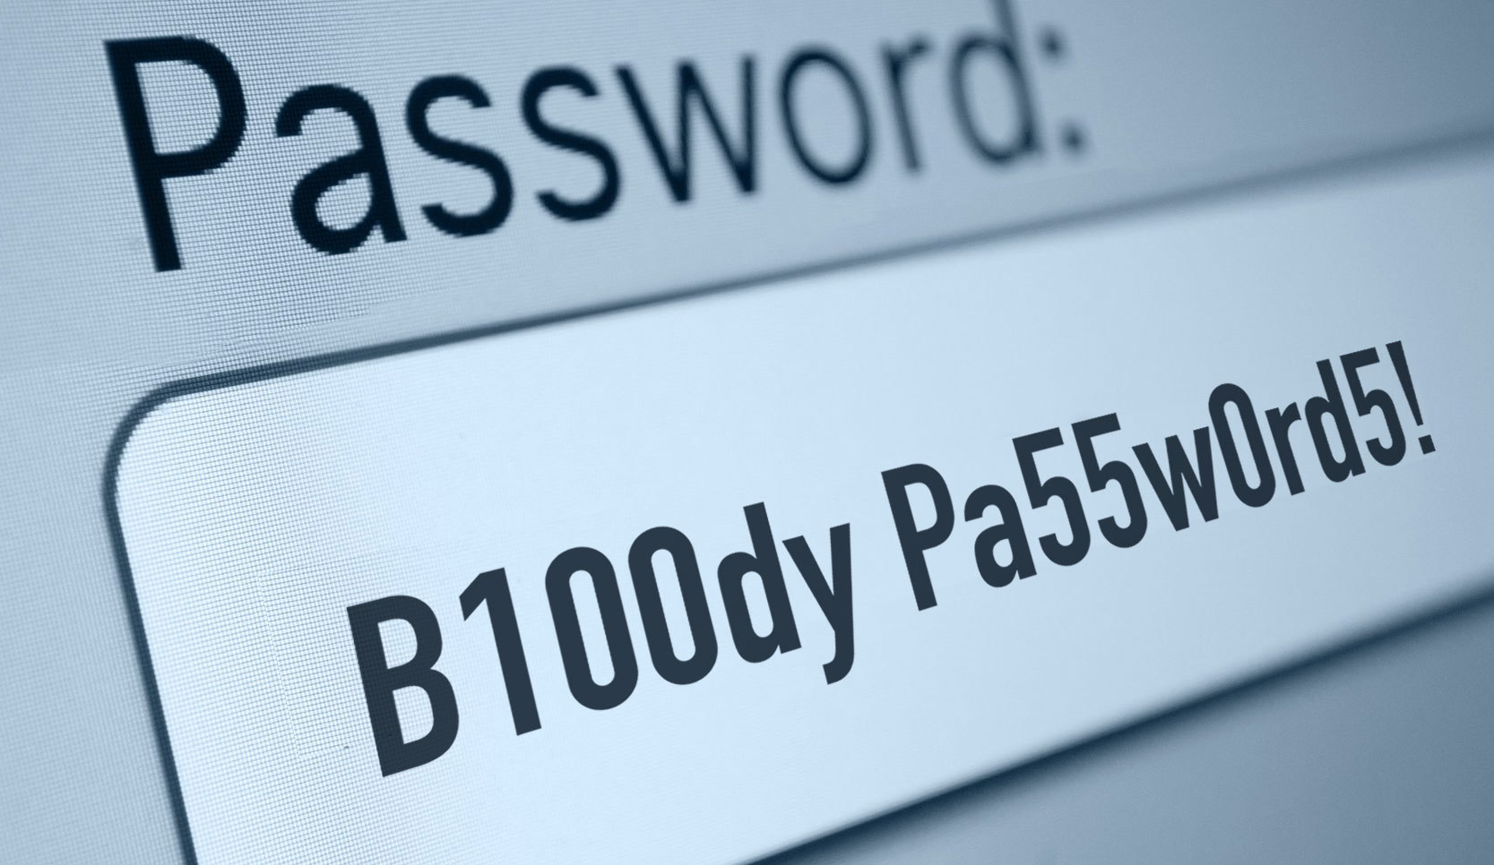
Protect your accounts: Passwords
Use strong passwords (includes numbers, letters and symbols)
  Weak passwords
    Username
    Birthday
    Children’s names
  Better passwords
    All4one
    for2Day
  Strong passwords
    pZg3tj1!

Slide 22
Protect your accounts: Passwords
Don’t share your password with anyone
Don’t write down your password and leave it on your desk
Don’t use the same password for multiple services
Make your password easy to remember
Change your password every 90 days

Slide 23
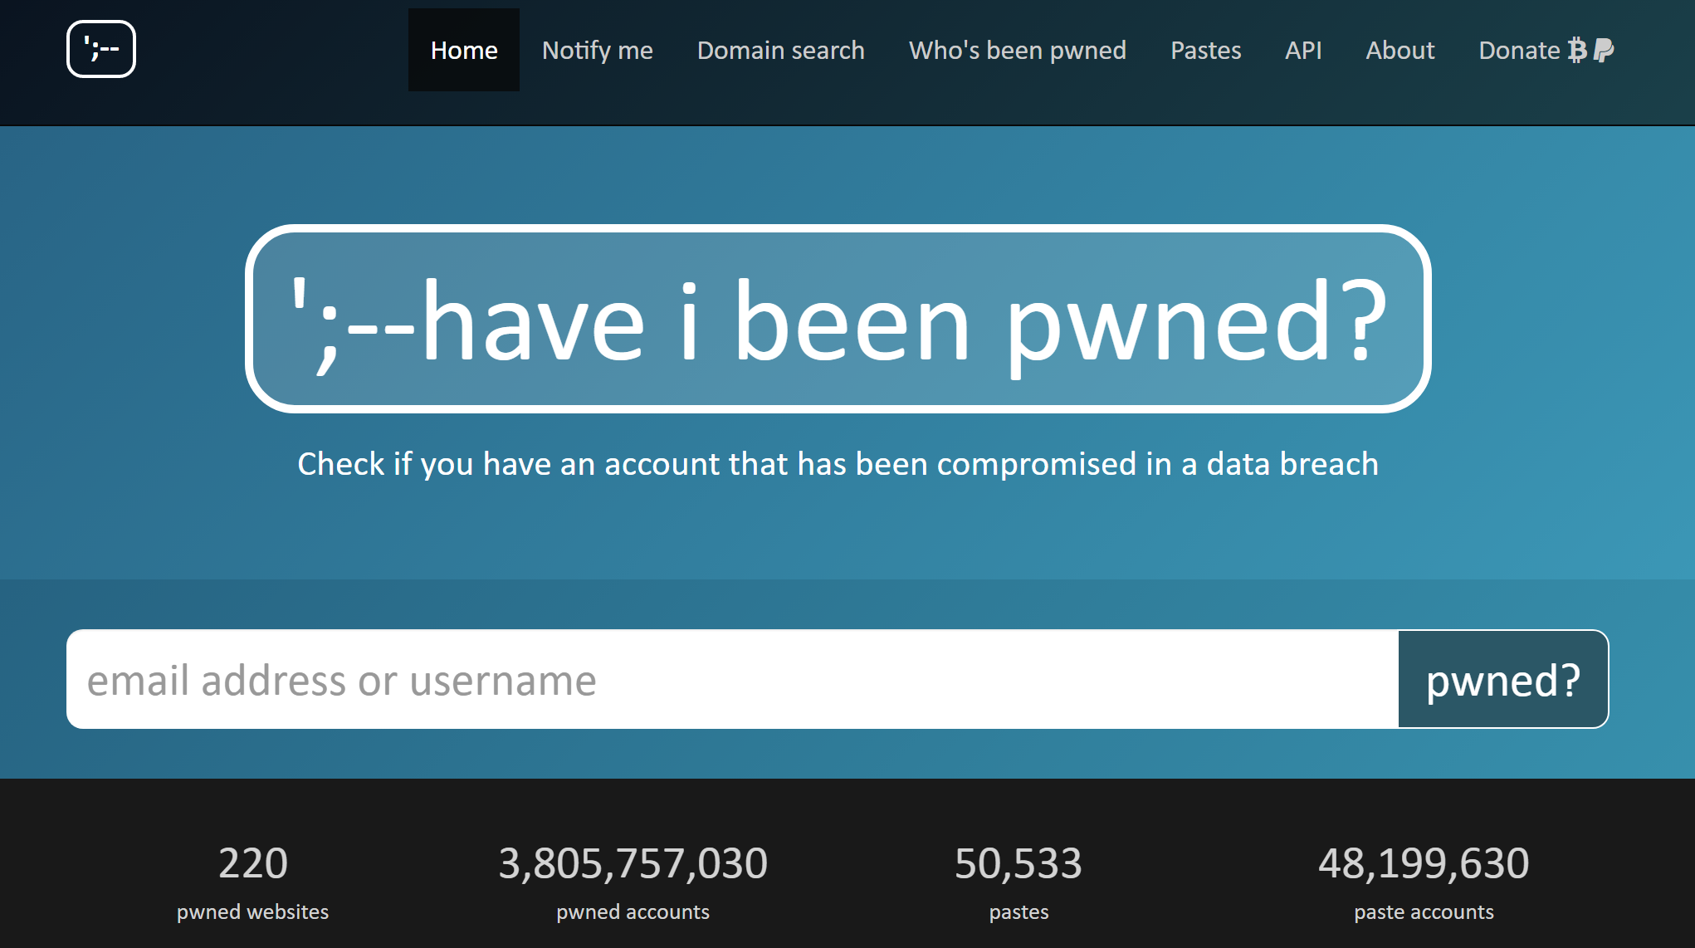

Slide 24
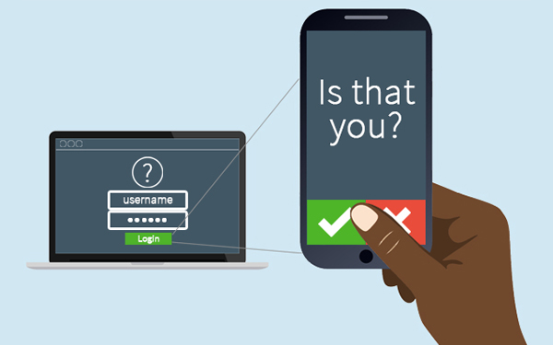
Protect your accounts: 2FA
If your accounts (Facebook, Gmail, Bank, etc.) support two factor authentication, use it.
Two factor sends you a text message or email with a special code when you’re logging on from an unknown device.

Slide 25
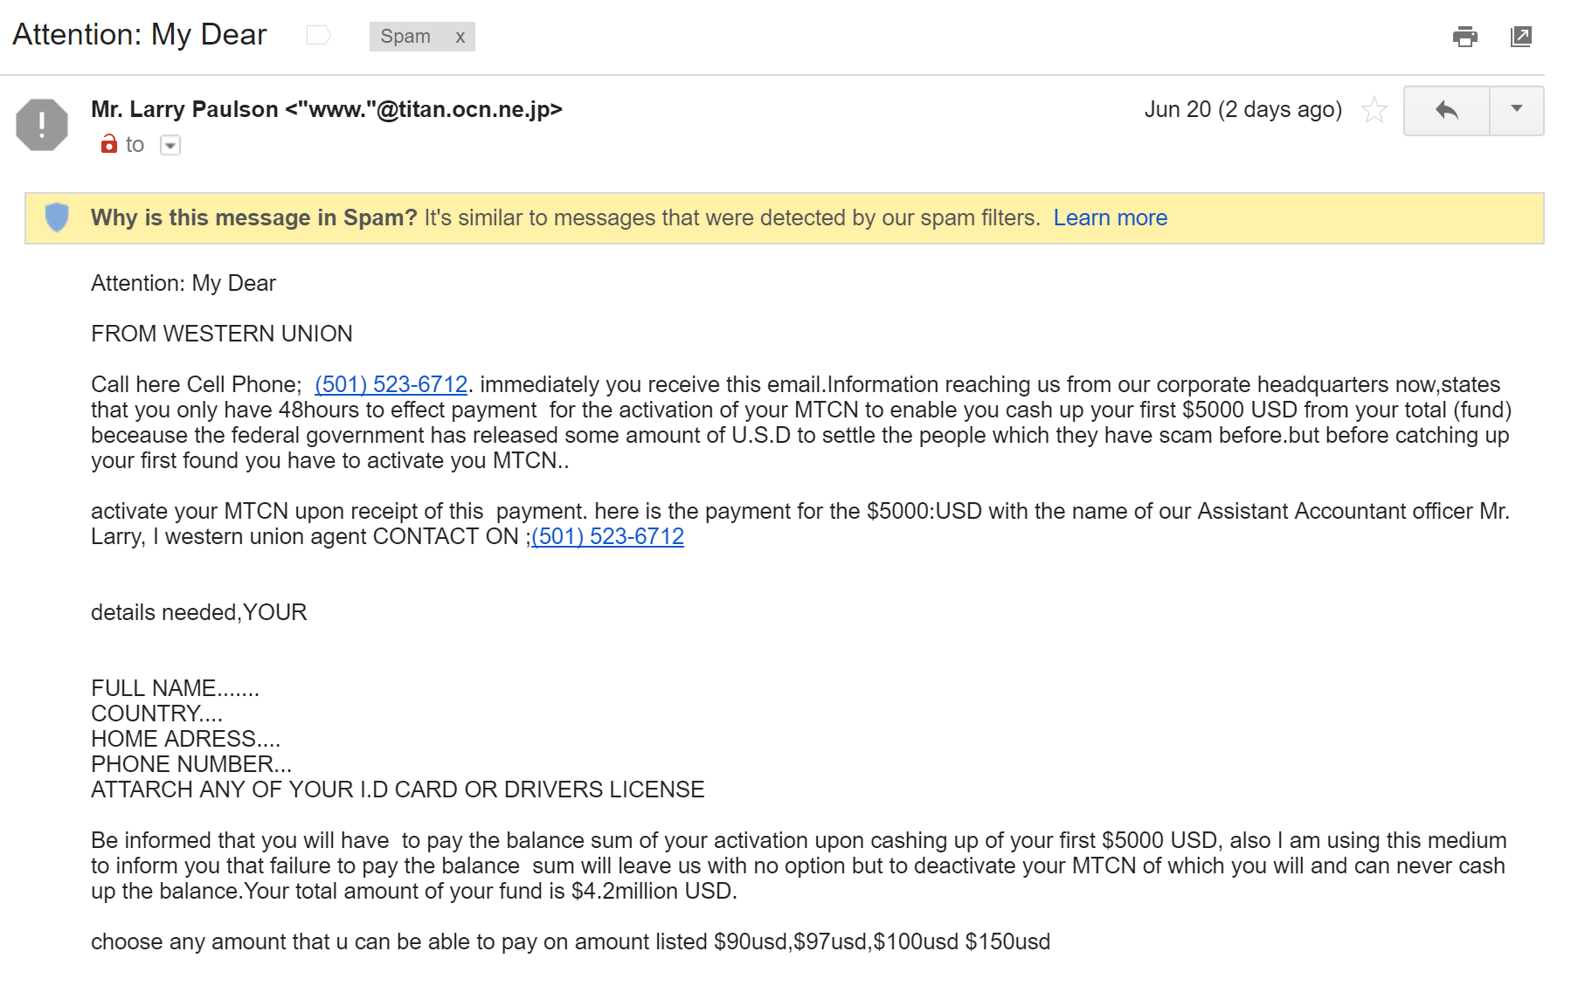
Common Attack Vectors: General Scams

Slide 26
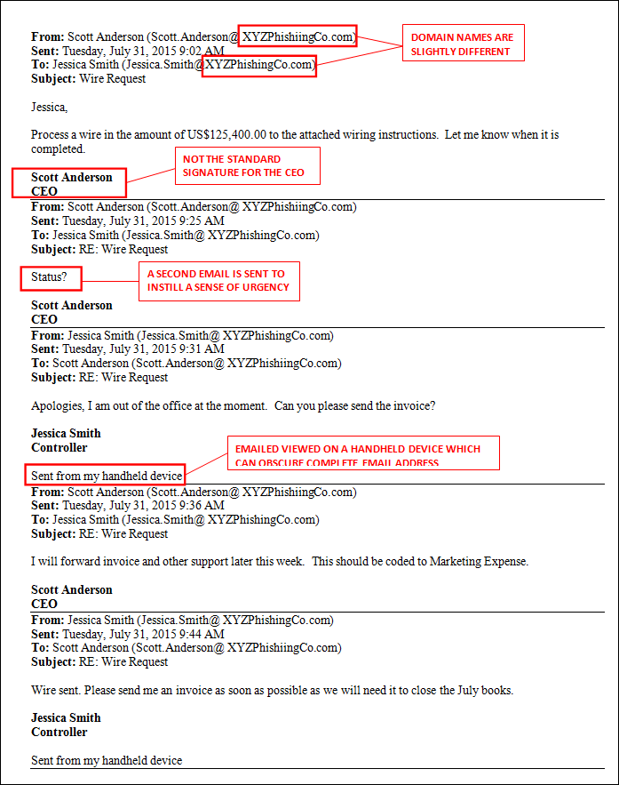
A common nonprofit email scam…
Cyber criminals are pulling staff data from your website and Form 990s

Slide 27
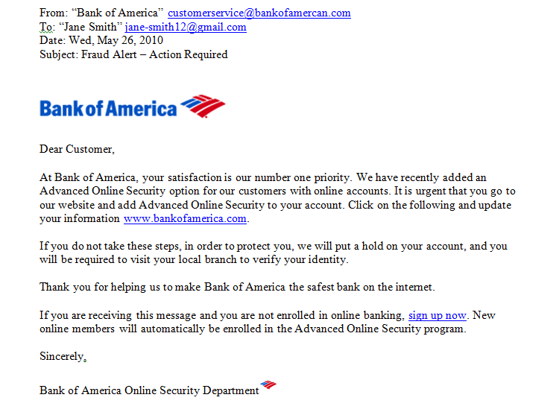
Common Attack Vectors: Phishing Emails
Phishing email characteristics include:
  Misspelled email domains
  Hyperlinks that don’t go where they say they will
  Threats of account shutdown if no action is taken
  Urgent subject lines

Slide 28
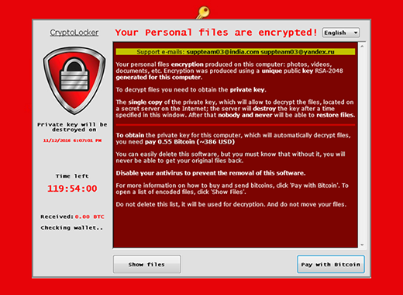
Common Attack: Cryptolocker
Cryptolocker downloads a piece of software to your computer that then encrypts anything file that it can access, including the file server.
After it’s done encrypting, a random screen appears and demands payment.
Usually delivered via an email attachment or rogue website

Slide 29
Avoiding Cryptolocker
Only open attachments from people you trust; if you think it’s a fake attachment, don’t open it.
  Office 365 and Google Apps automatically scans attachments, but criminals are always one step ahead.
Check any hyperlinks in email by hovering over them. Make sure the website goes to where it’s supposed to go to and not to a URL shortening service like bit.ly.

Slide 30
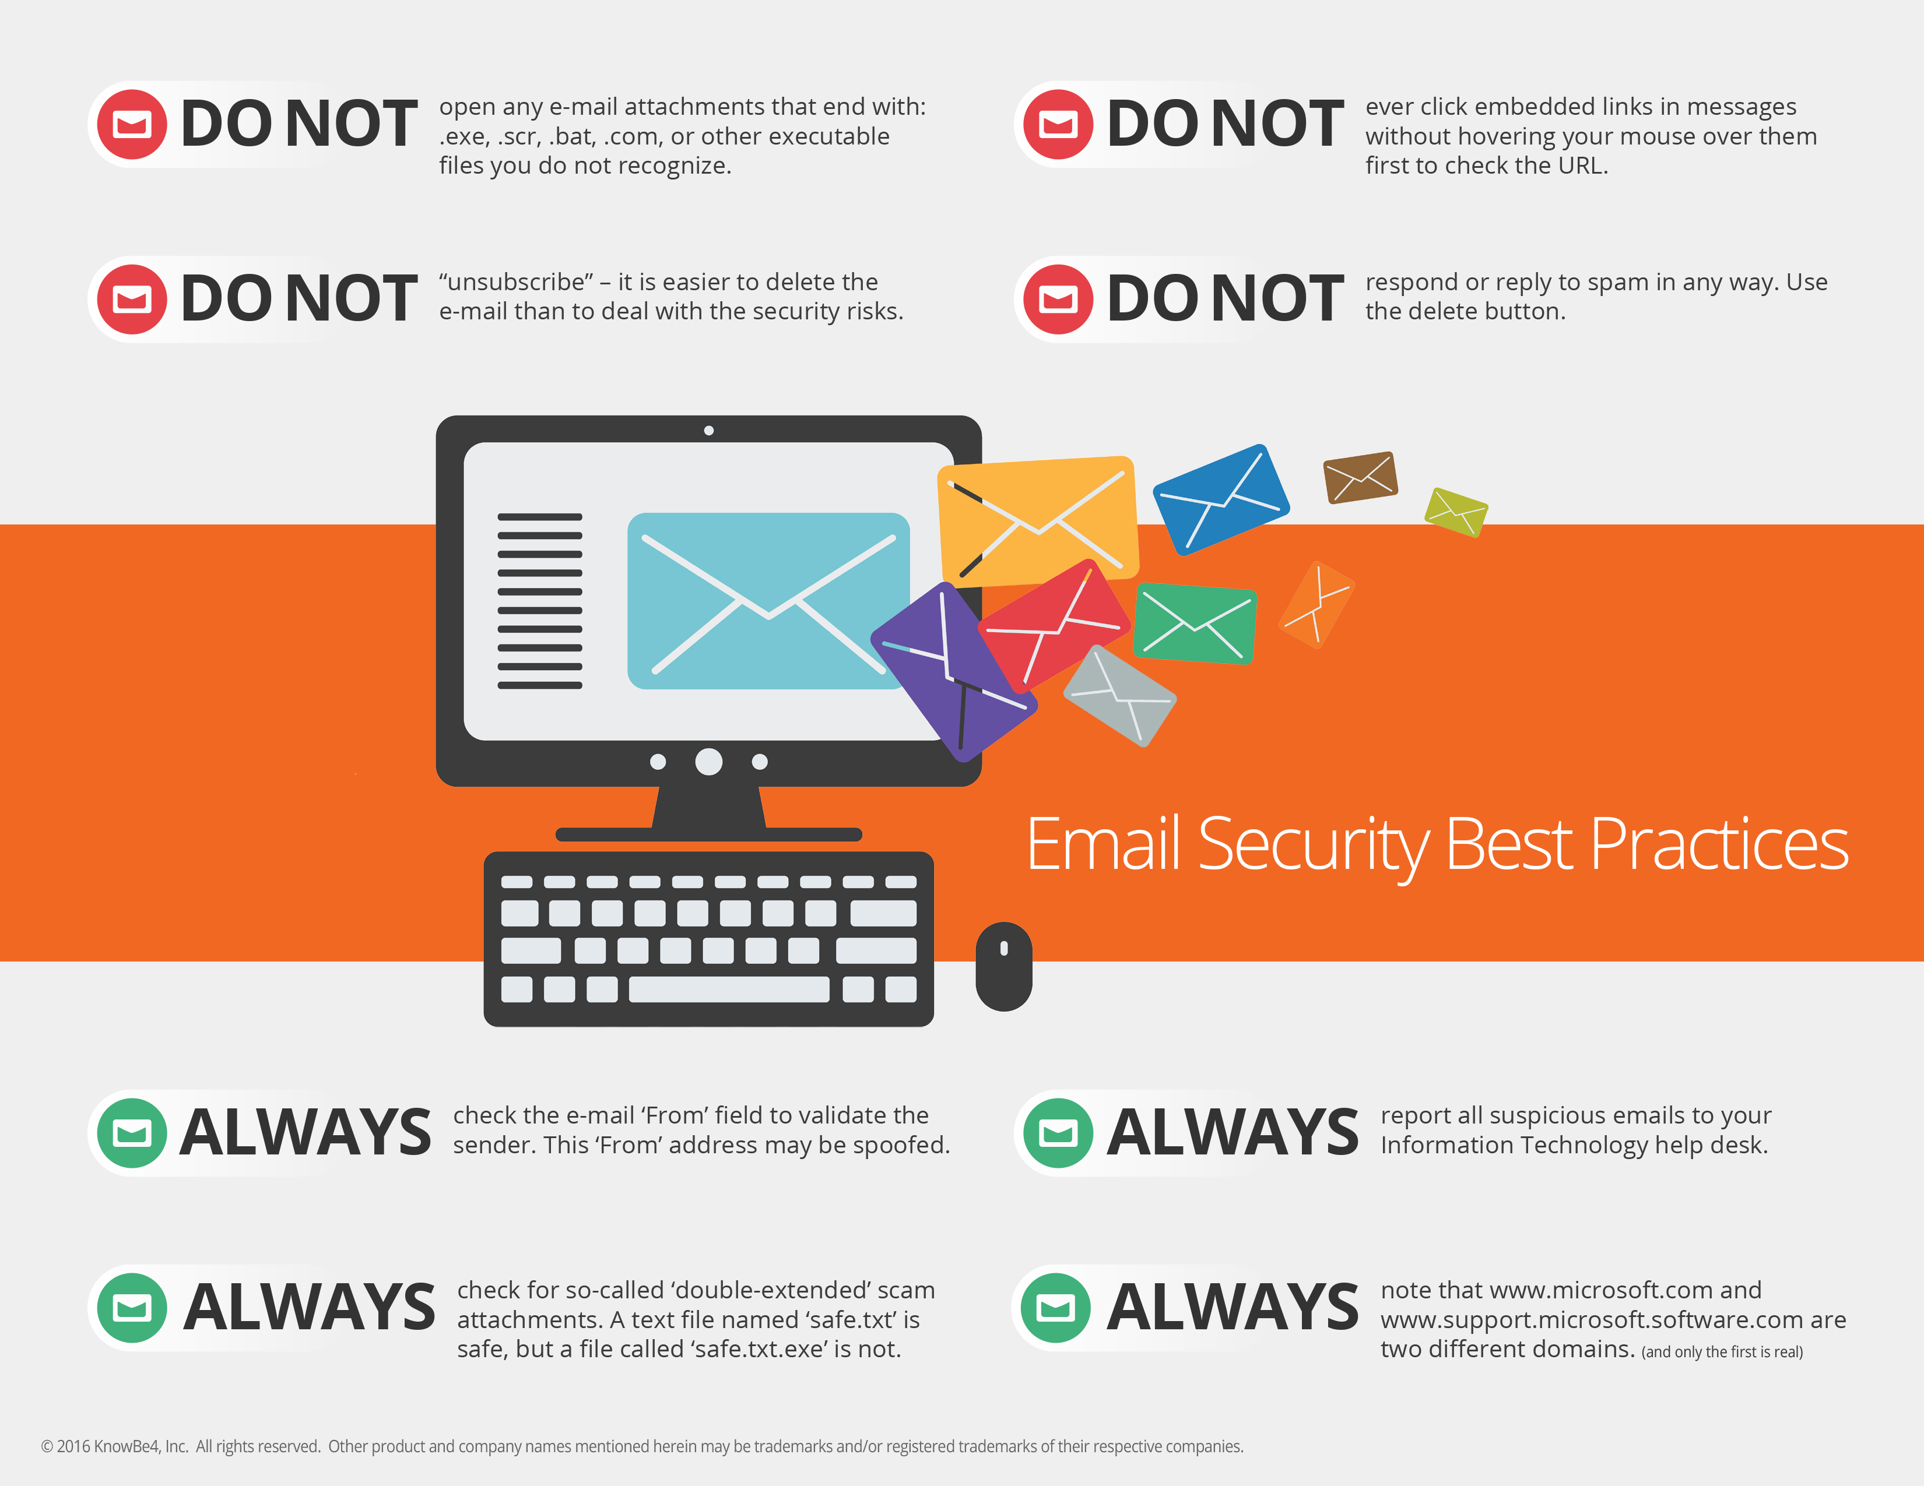

Slide 31
Implementing Policies to Protect Your Workforce
WISP (Written Information Security Policy)
  Massachusetts requires this to comply with the law
BYOD Policy
  This policy covers any mobile device capable of coming into contact with your companies' data.
Password Policy
  This policy would apply to any person who is provided an account connected to your corporate network or systems, including: employees, guests, contractors, partners, vendors, etc.
Notes:
BYOD - A more mobile workforce is a more flexible and productive workforce. For this reason, business use of mobile devices is growing, and as these devices become vital tools to conduct business, more and more sensitive data is stored on them, and thus the risk associated with their use is growing.
Password Policy – protects you from cybercrime in your workplace. For example, employees need to change passwords every 3 months.
WISP- Note that this applies to “every person” and includes one-person companies through SMBs to large enterprises. If your company suffers a security breach and does not have a WISP, then things are probably not going to turn out well. Indeed, the penalties can be severe, and don’t expect to be let off with a slap of the wrist just because you are a small company.
This happened to Ned Devine’s, the Irish pub that is a Boston landmark. The Briar Group, the company that owns Ned’s and several other popular venues, was fined $110,000 by the the Attorney General to settle allegations that the restaurant chain “failed to take reasonable steps to protect its patrons’ personal information, thereby putting the payment card information of tens of thousands of consumers at risk.”

Slide 32
Any questions?

Slide 33
Thank you for attending
All attendees will receive:
  A customizable BYOD template to use at your organization
  15% off an IT security assessment performed by TNB

